Slide 3
OUR HISTORY
Founded in 1991 by talented engineers and music lovers Peter Thomas and Adrian Loader.
The combination of knowledge and a life-long passion for music led to the production of PMC’s first product, the BB5-XBD-A, an active main studio monitor.

Slide 4
WHAT MAKES PMC
All PMC loudspeakers are developed using our pioneering ATL bass loading system
By using advanced engineering and technologies our speakers can reproduce music vividly and faithfully; that’s why our designs are used by the world’s leading studios and music lovers.
All of our speakers are designed and manufactured by hand in the United Kingdom.

Slide 5
STEREO TO SPATIAL
PMC has been involved in the creation of all audio formats for over 30 years.
From the early days where DTS asked us to demonstrate their 5.1 material in its best light; to today's immersive formats for movies and music.

Slide 6
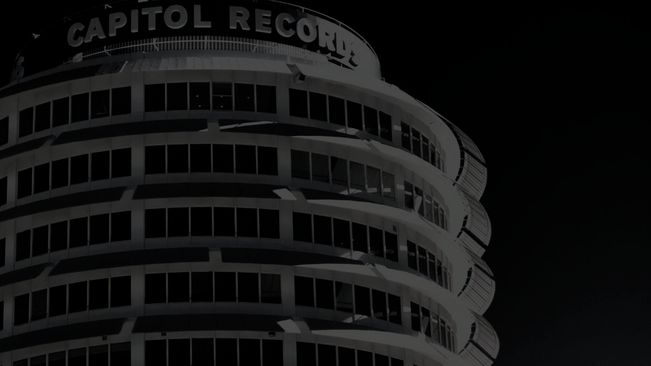
CAPITOL STUDIOS
In 2013 Capitol Studios asked us to build them the ultimate loudspeaker for their legendary studios A & B in Hollywood and we delivered the QB1.
We then worked further with them to develop studio c to become the first immersive music mix facility.

Slide 7
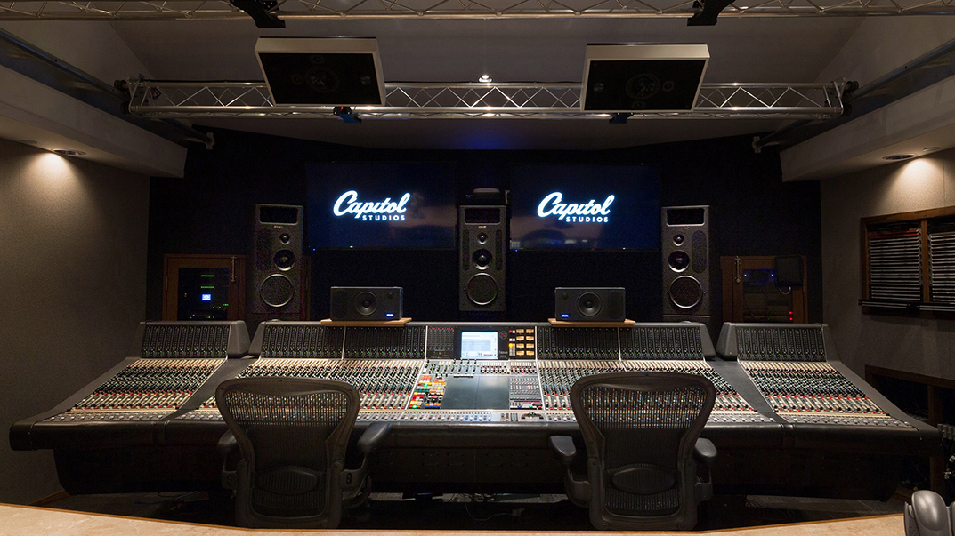
CAPITOL STUDIOS, HOLLYWOOD

Slide 8
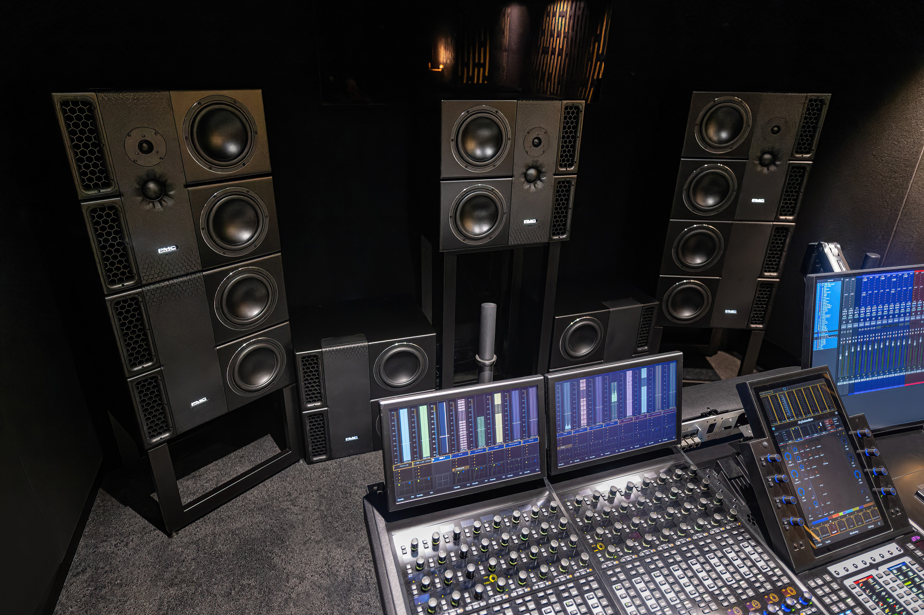
DOLBY HEADQUARTERS
We installed a 9.1.6 system for Dolby Laboratories as their reference facility for music, movie and gaming.
Since then, PMC has become the leaders in immersive audio monitoring systems worldwide.
And a reference for immersive music mixing.

Slide 9
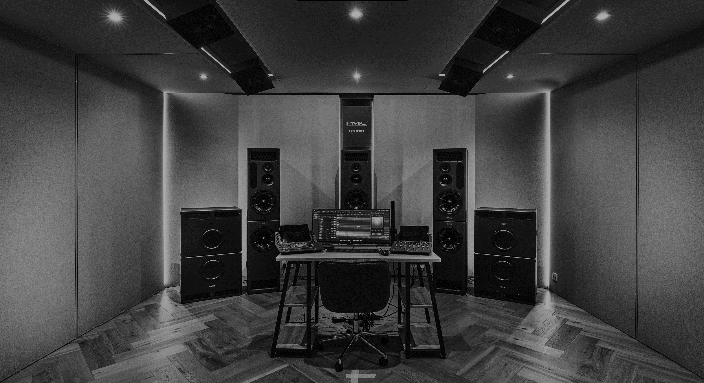
PMC STUDIOS
We have our own immersive mixing studios in London,
Los Angeles, New York and Nashville.
We work with, engineers, producers and musicians in order to help them transition into the world of immersive audio
Our engineering team have mixed for some of the biggest artists, including Miles Davis, SEAL, & Carole King

Slide 10
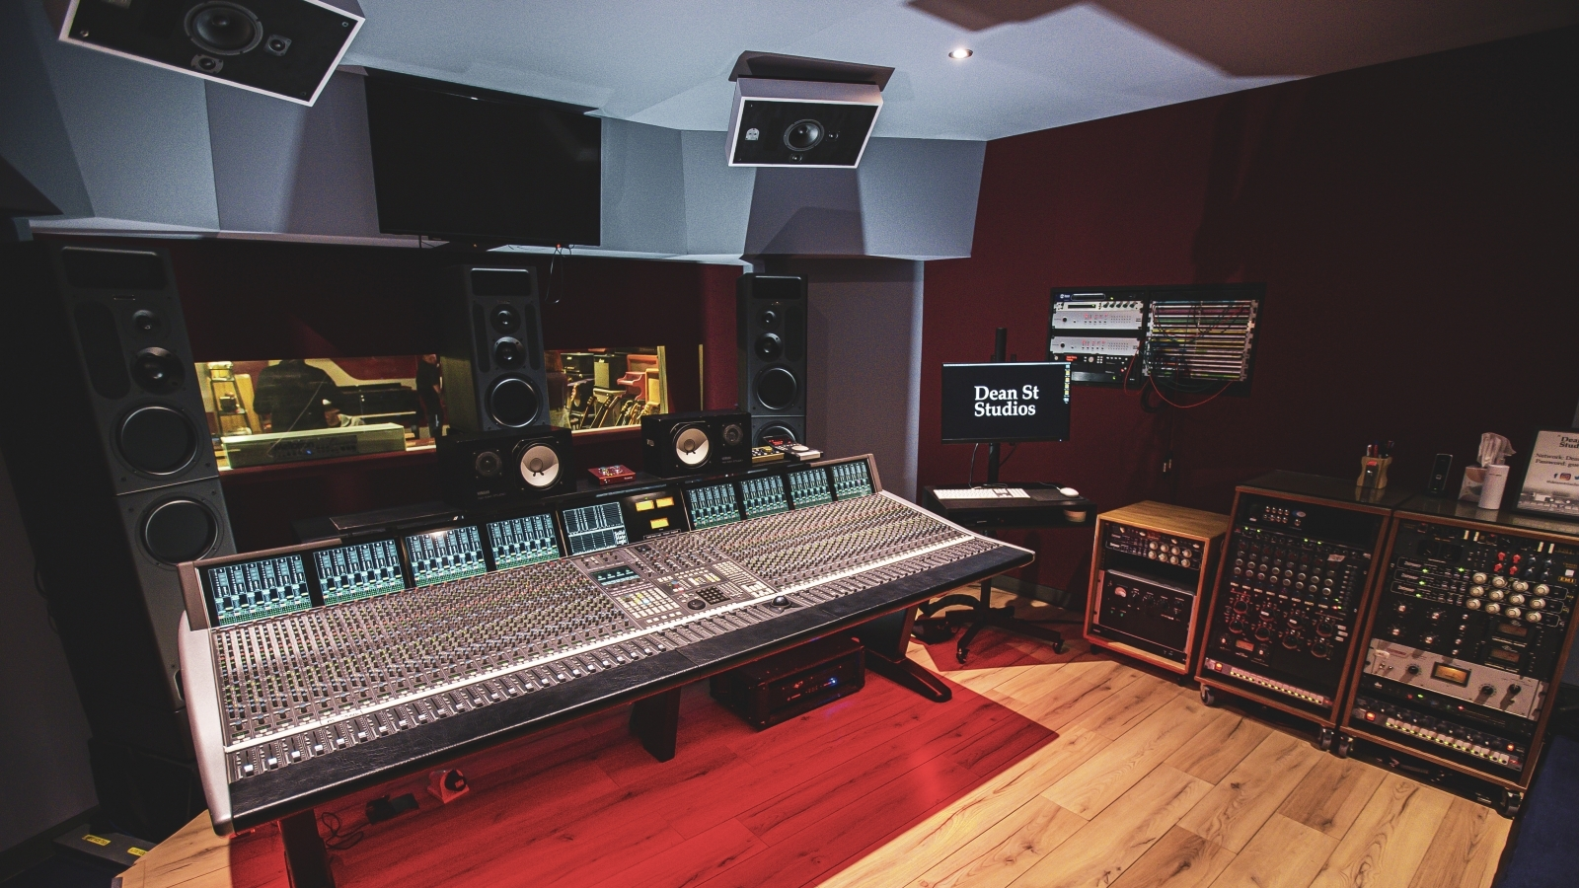
DEAN ST STUDIOS, LONDON

Slide 11
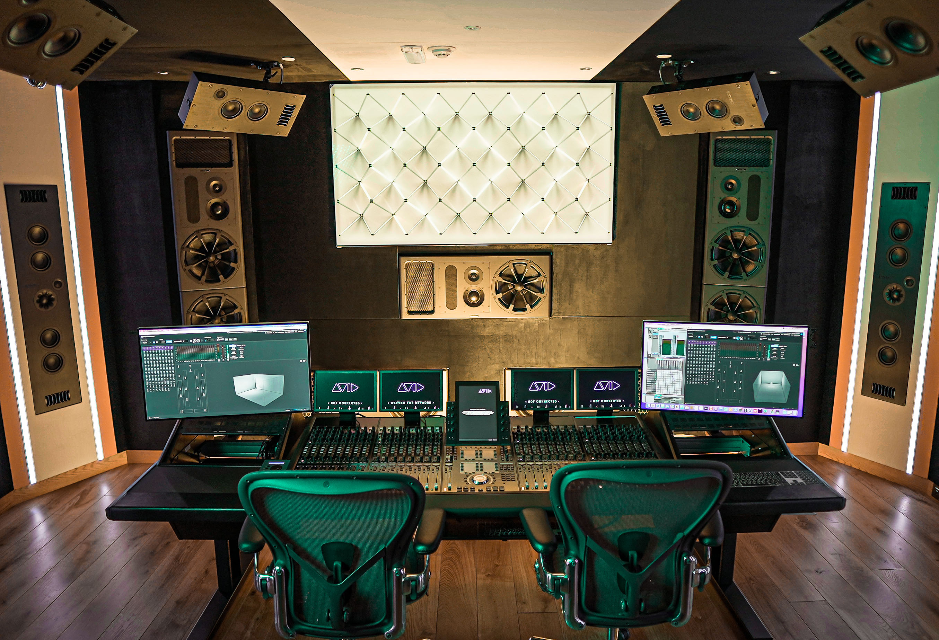
LP.ME STUDIOS, DUBAI

Slide 12
THE SYSTEM
11.4.6 Atmos
21 Loudspeakers
Flagship BB6-XBD-A L,C,R
4 x PMC BST Subwoofers
PMC Ci Series Surrounds
48,000 watts
Frequencies down to 15hz
System value €300,000

Slide 13
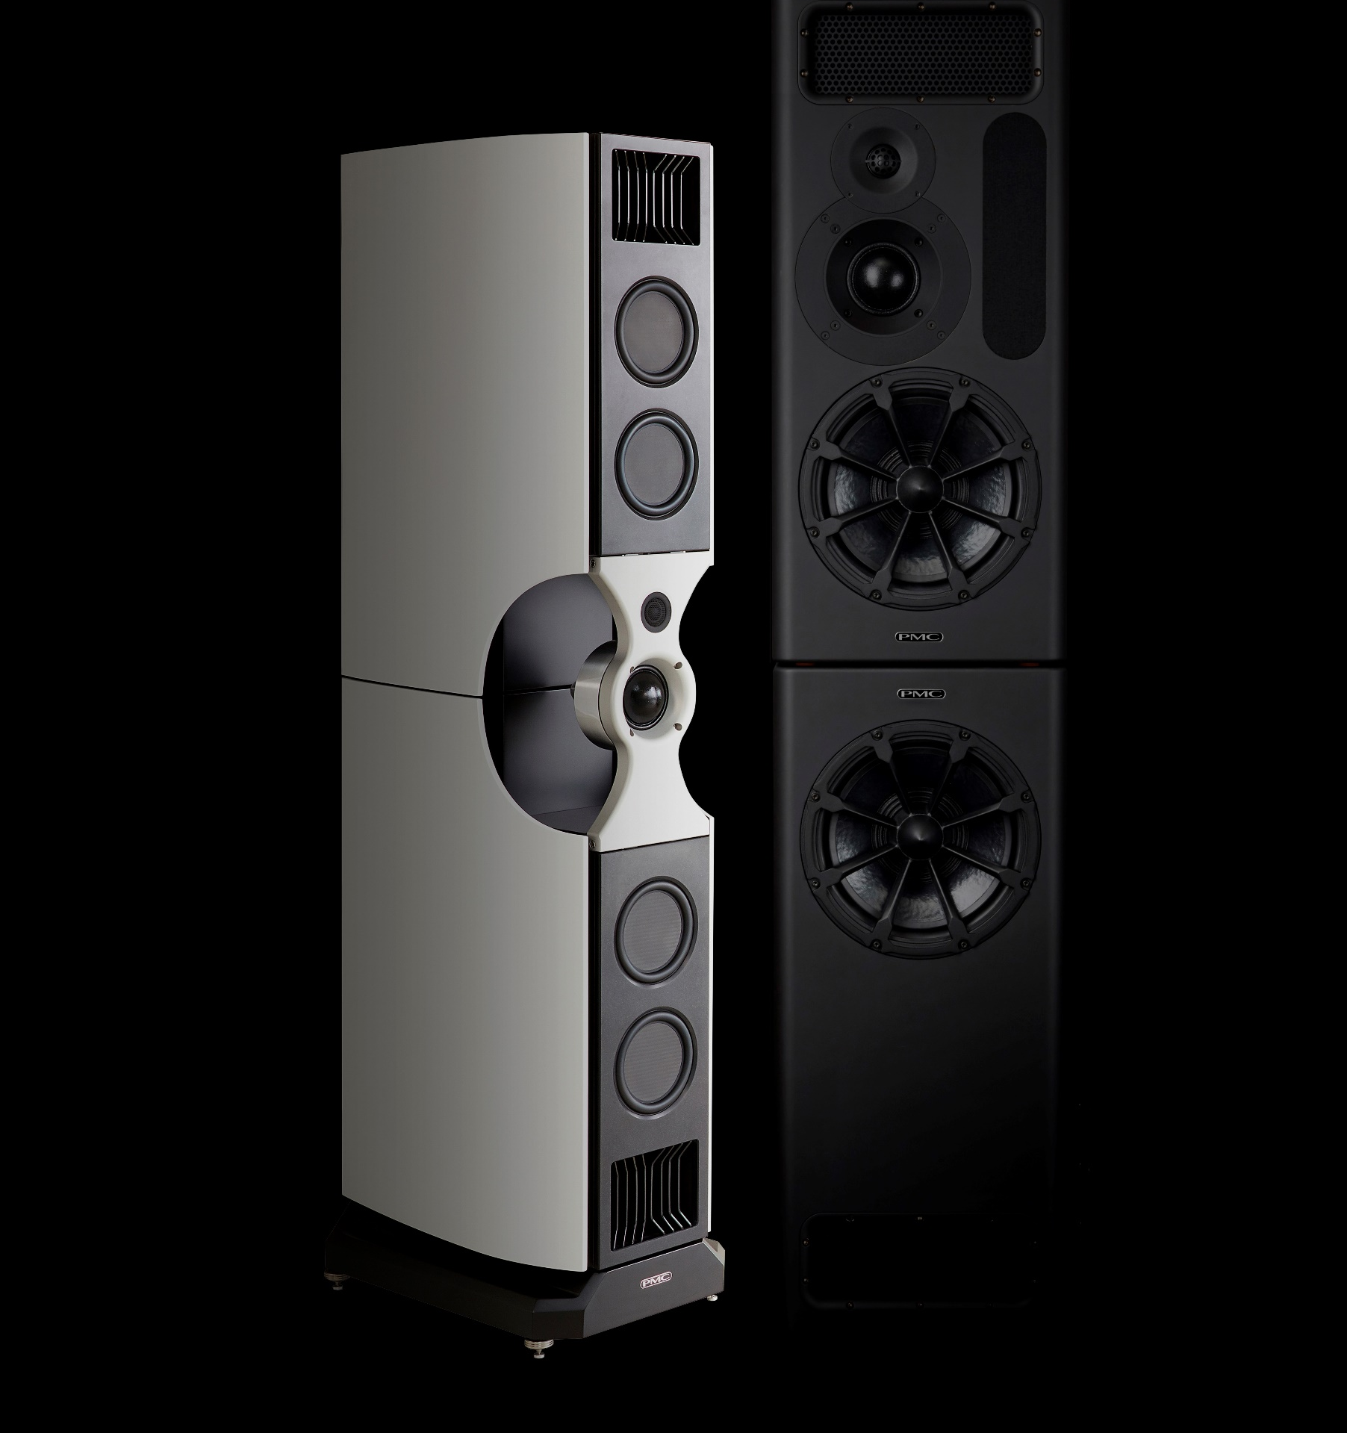
JOIN US
If you would like to learn more about PMC
PMC Room D106, Atrium 3

Slide 14
STEVEN WILSON
Musician, songwriter, producer, and Grammy-nominated
spatial audio mix engineer
Notes:
It is a pleasure to introduce Steven Wilson
Musician, Songwriter, producer & Grammy nominated spatial audio engineer

Slide 15
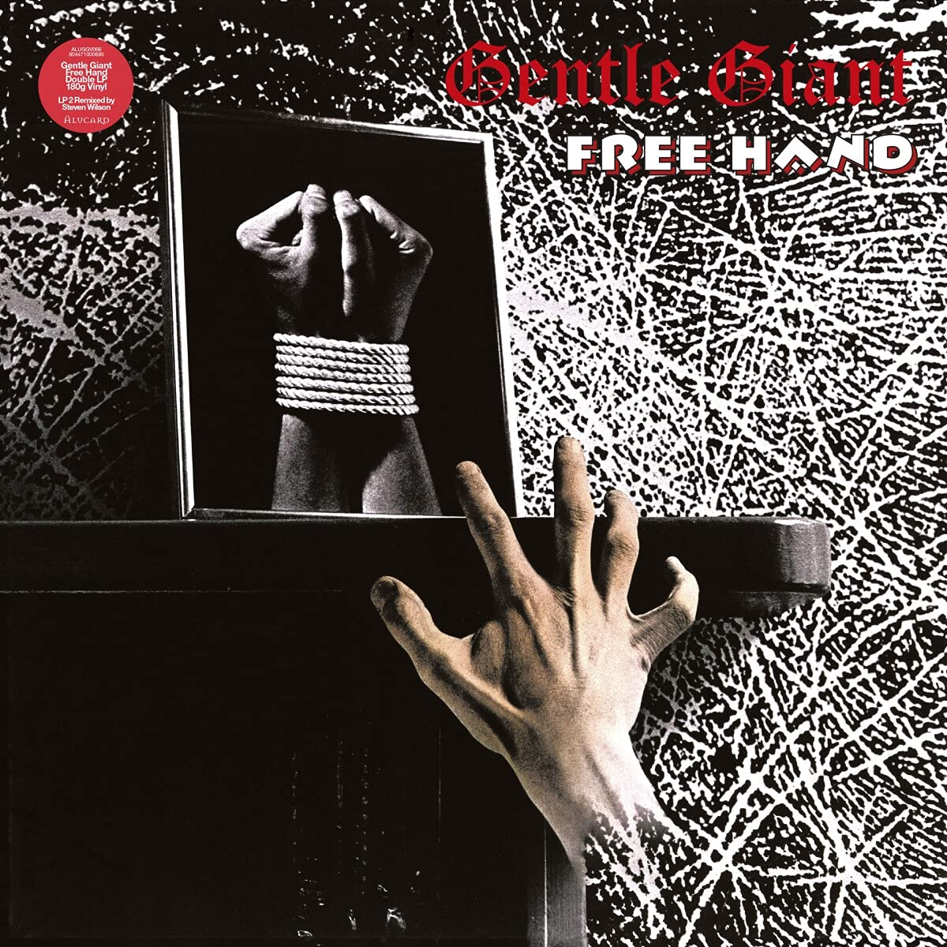
GENTLE GIANT
On Reflection

Slide 16
TEARS FOR FEARS
Rivers of Mercy

Slide 17
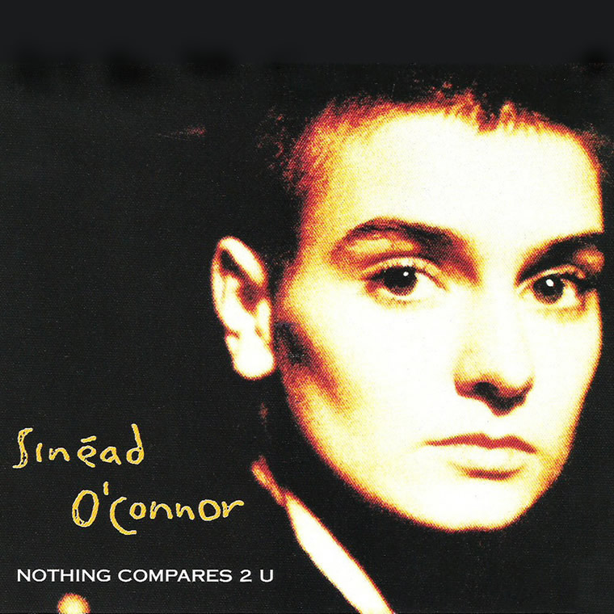
SINEAD O’CONNOR
Nothing Compares 2 U

Slide 18
THE WHO
BABA O’RILEY

Slide 19
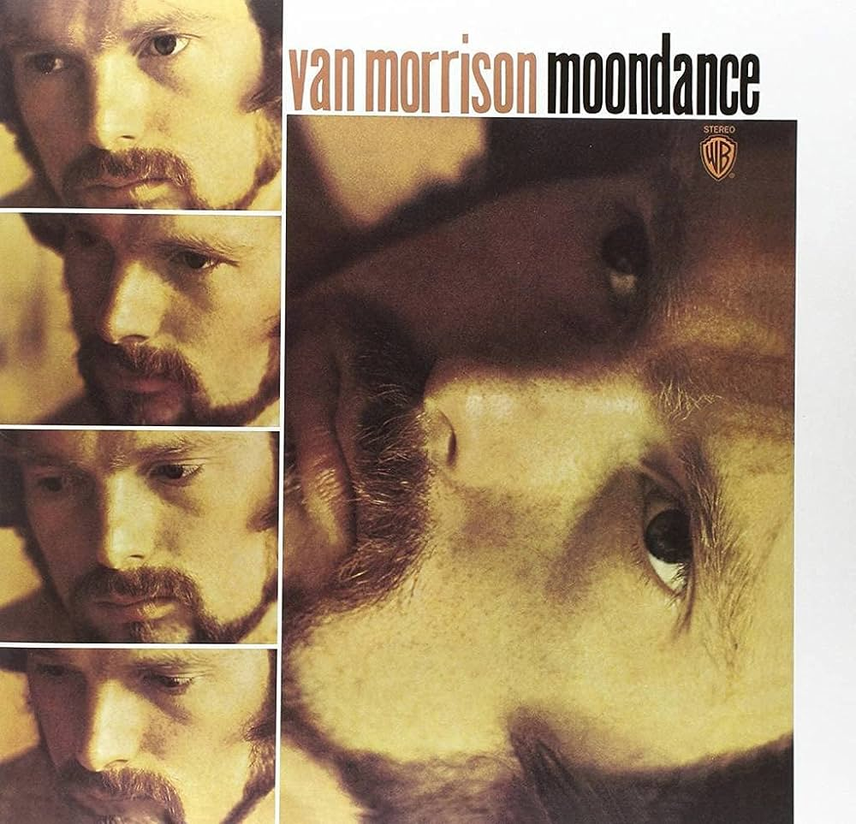
VAN MORRISON
Moondance

Slide 20
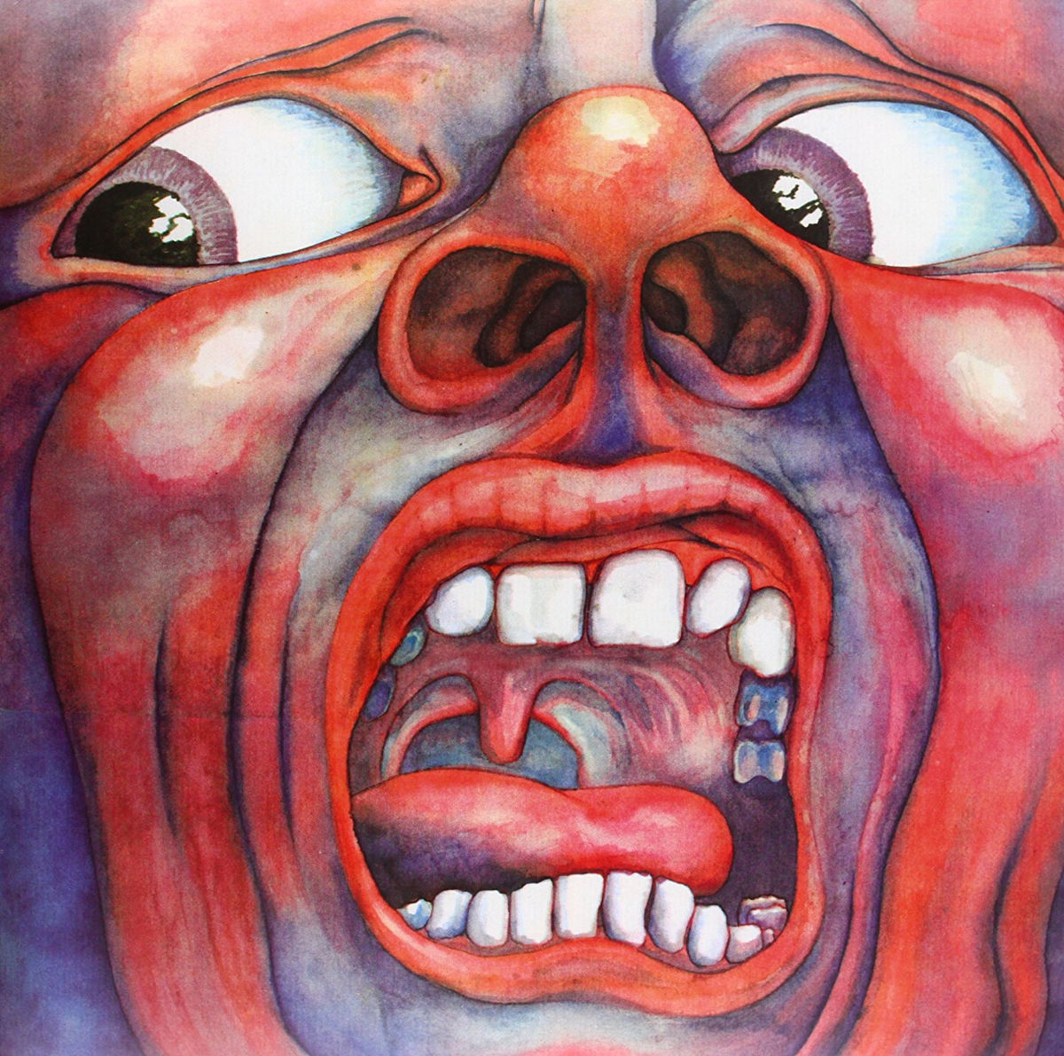
KING CRIMSON
I Talk to the Wind

Slide 21
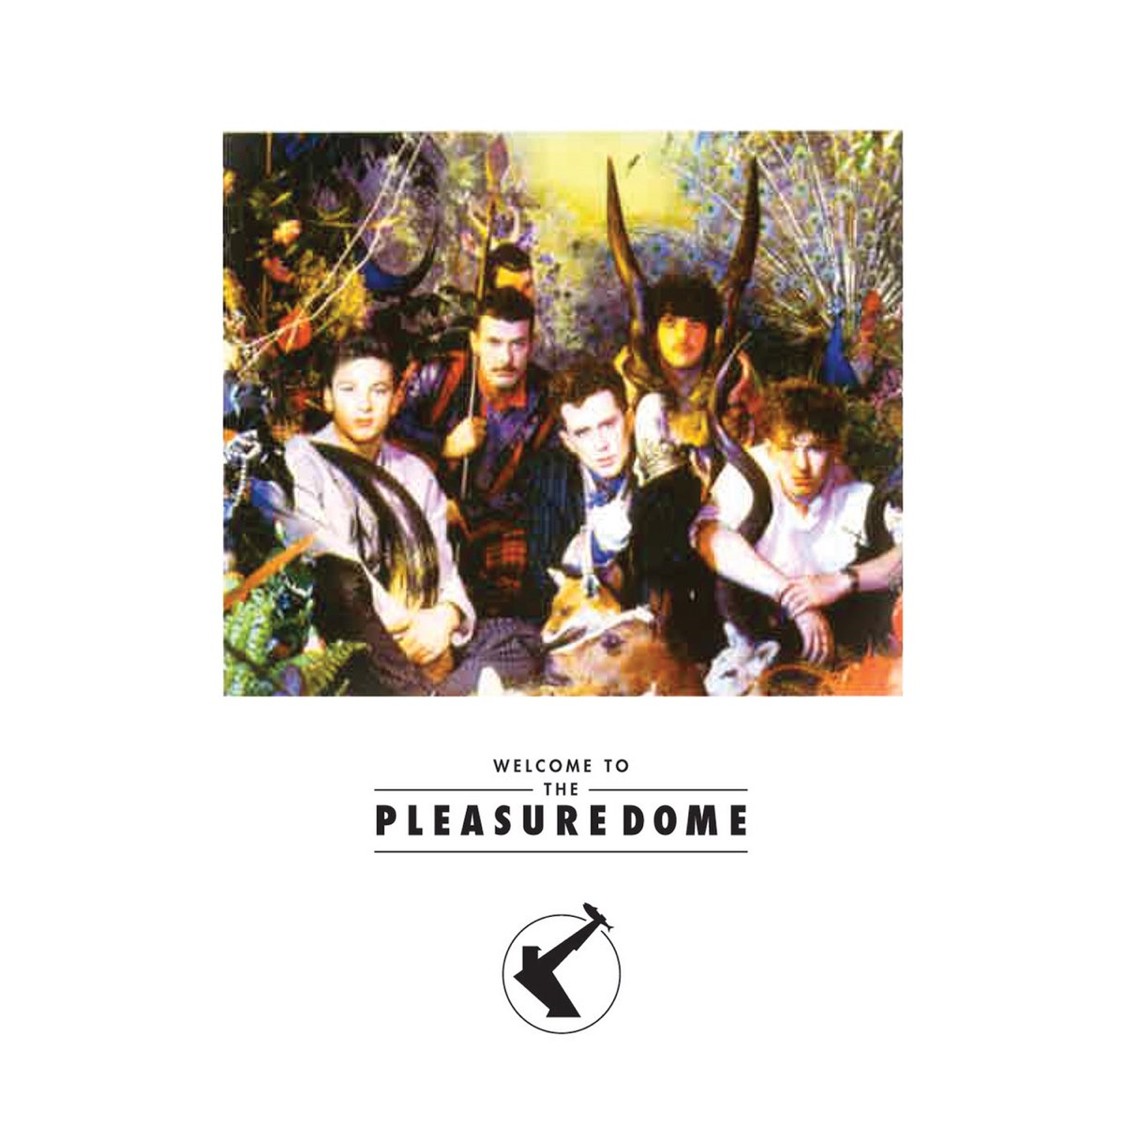
FRANKIE GOES TO HOLLYWOOD
Welcome to the Pleasuredome

Slide 22
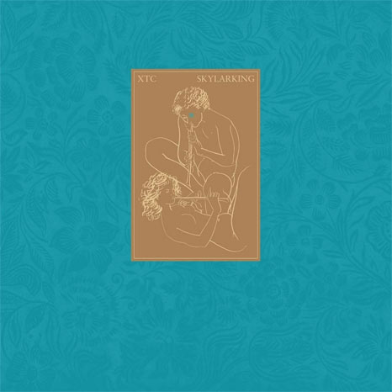
XTC
Season Cycle

Slide 23
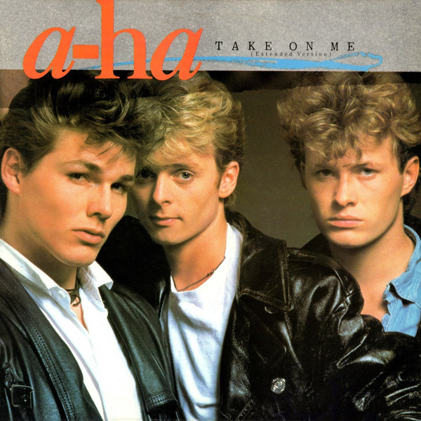
A-HA
Take On Me

Slide 24
STEVEN WILSON
Staircase

Slide 25
Questions?

Slide 26
End of Presentation

